Slide 1
Random search method tutorial
Yavorskyi Vladyslav, 박재선, 나용호
Korea University 2017

Slide 2
Contents
Introduction to a problem
Algorithms
Experiment setup and results
Conclusions

Slide 3
Introduction to a problem

Slide 4
Introduction to a problem
Most machine learning algorithms have hyper-parameters that must be determined in advance.
Performance of algorithms may greatly vary depending on the set of hyper-parameters that we chose.
Therefore hyper-parameter optimization is very important.

Slide 5
Introduction to a problem
The traditional way of performing hyperparameter optimization has been grid search.
Grid search suffers from the curse of dimensionality.
Random search is a randomized search that simply samples parameter settings a fixed number of times.
oftentimes, it turns out some hyperparameters do not significantly affect the loss.
found to be more effective in high-dimensional spaces than exhaustive search.
each model is independent, it is also effective when creating models in parallel on several computers.

Slide 6
Algorithms

Slide 7
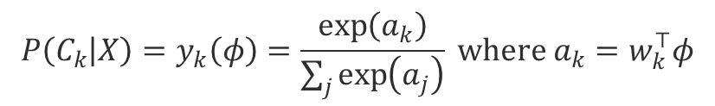
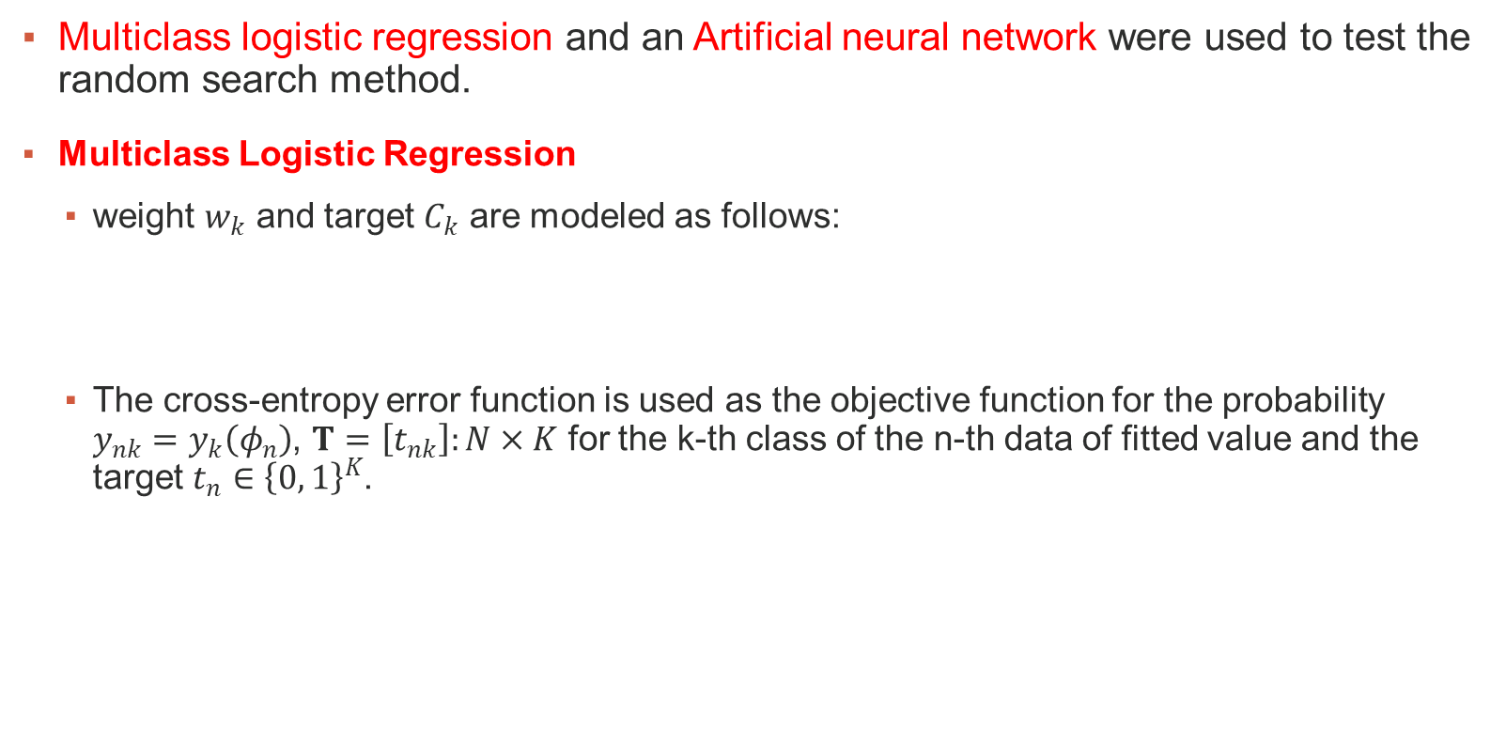
Algorithms
Multiclass logistic regression and an Artificial neural network were used to test the random search method.
Multiclass Logistic Regression
weight $w_{k}$ and target $C_{k}$ are modeled as follows:
The cross-entropy error function is used as the objective function for the probability $y_{nk}=y_{k}\left(φ_{n}\right)$, $T=\left[t_{nk}\right]:N×K$ for the k-th class of the n-th data of fitted value and the target $t_{n}∈{\left\{0, 1\right\}}^{K}$.
$$P\left(C_{k} | X\right)=y_{k}\left(φ\right)=\frac{\exp\left(a_{k}\right)}{\sum_{j}{\exp\left(a_{j}\right)}} where a_{k}=w_{k}^{⊤}φ$$

Slide 8

Multiclass Logistic Regression
After using regularization term for generalizing and applying gradient descent to minimize the objective function we receive
where $η$, $τ$ are learning rate and step, respectively.

Slide 9
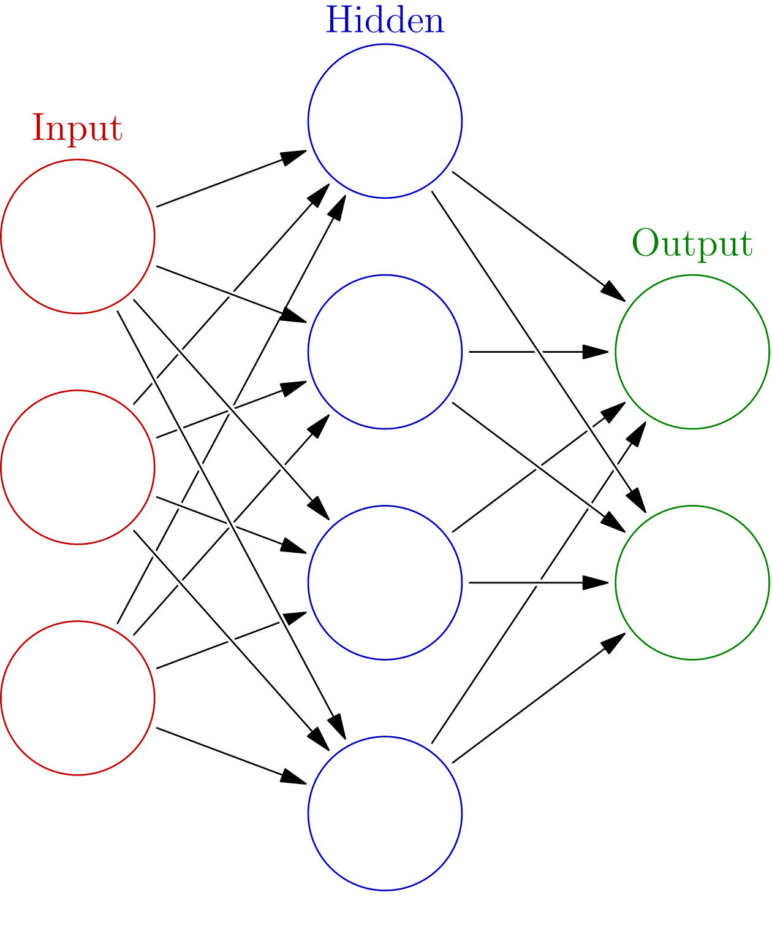
Artificial Neural Network
Similar to the logistic regression, we trained the gradient descent with cross entropy and regularization term.
Figure 1 Artificial Neural Network

Slide 10
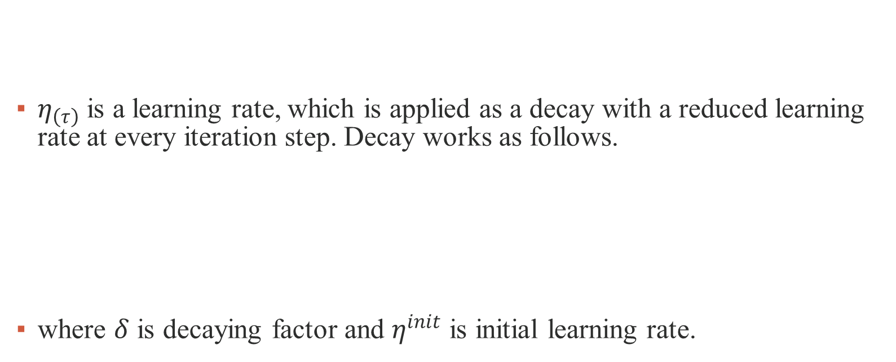
Artificial Neural Network
$η_{\left(τ\right)}$is a learning rate, which is applied as a decay with a reduced learning rate at every iteration step. Decay works as follows.
where $δ$ is decaying factor and $η^{init}$ is initial learning rate.

Slide 11
Experiment results

Slide 12
Dataset
The algorithm of section 3 was applied to MNIST hand-written digits dataset.
Each data is a 28 × 28 gray scale image, and when it is flattened, it has 784 variables.
There are 60,000 training sets and 10,000 test sets.
Figure 2 MNIST hand-written data

Slide 13
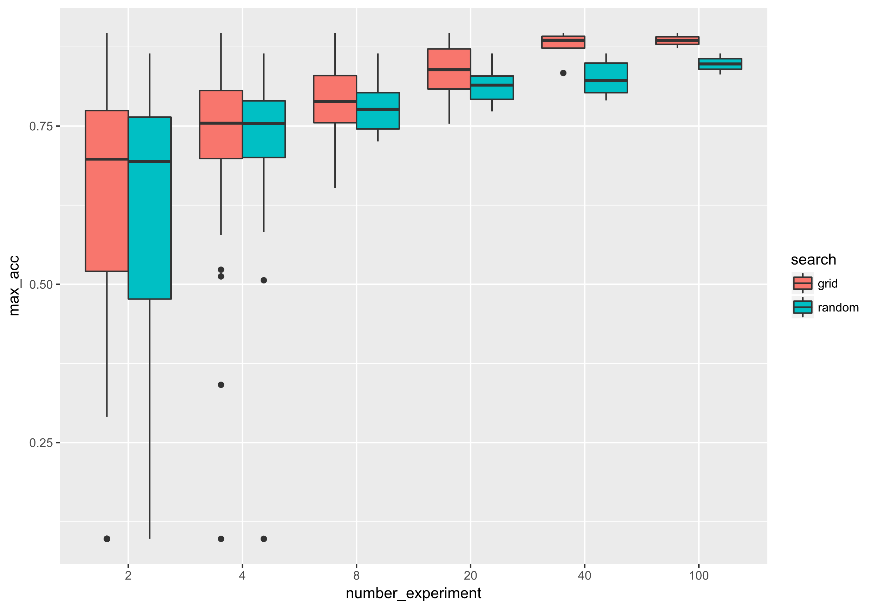
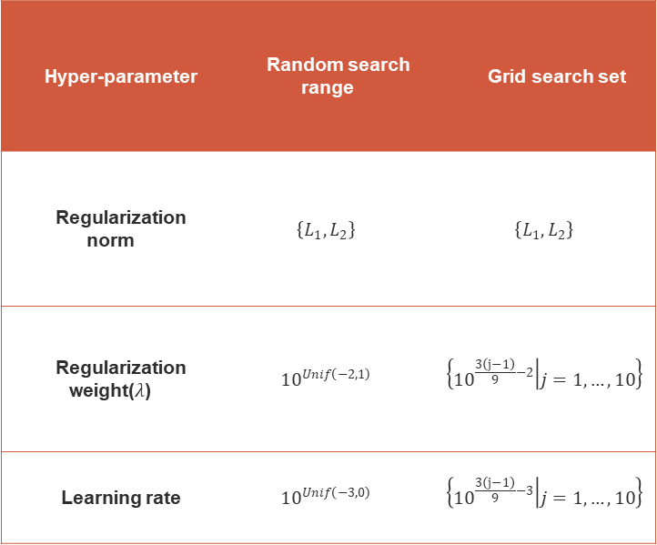
Multiclass Logistic Regression
Hyper-parameter | Random search range | Grid search set
Regularization norm | $$\left\{L_{1}, L_{2}\right\}$$ | $$\left\{L_{1}, L_{2}\right\}$$
Regularization weight($λ$) | $${10}^{Unif\left(−2, 1\right)}$$ | $$\left\{{10}^{\frac{3\left(j−1\right)}{9}−2} | j=1, …, 10\right\}$$
Learning rate | $${10}^{Unif\left(−3, 0\right)}$$ | $$\left\{{10}^{\frac{3\left(j−1\right)}{9}−3} | j=1, …, 10\right\}$$
Figure 3 Logistic regression

Slide 14
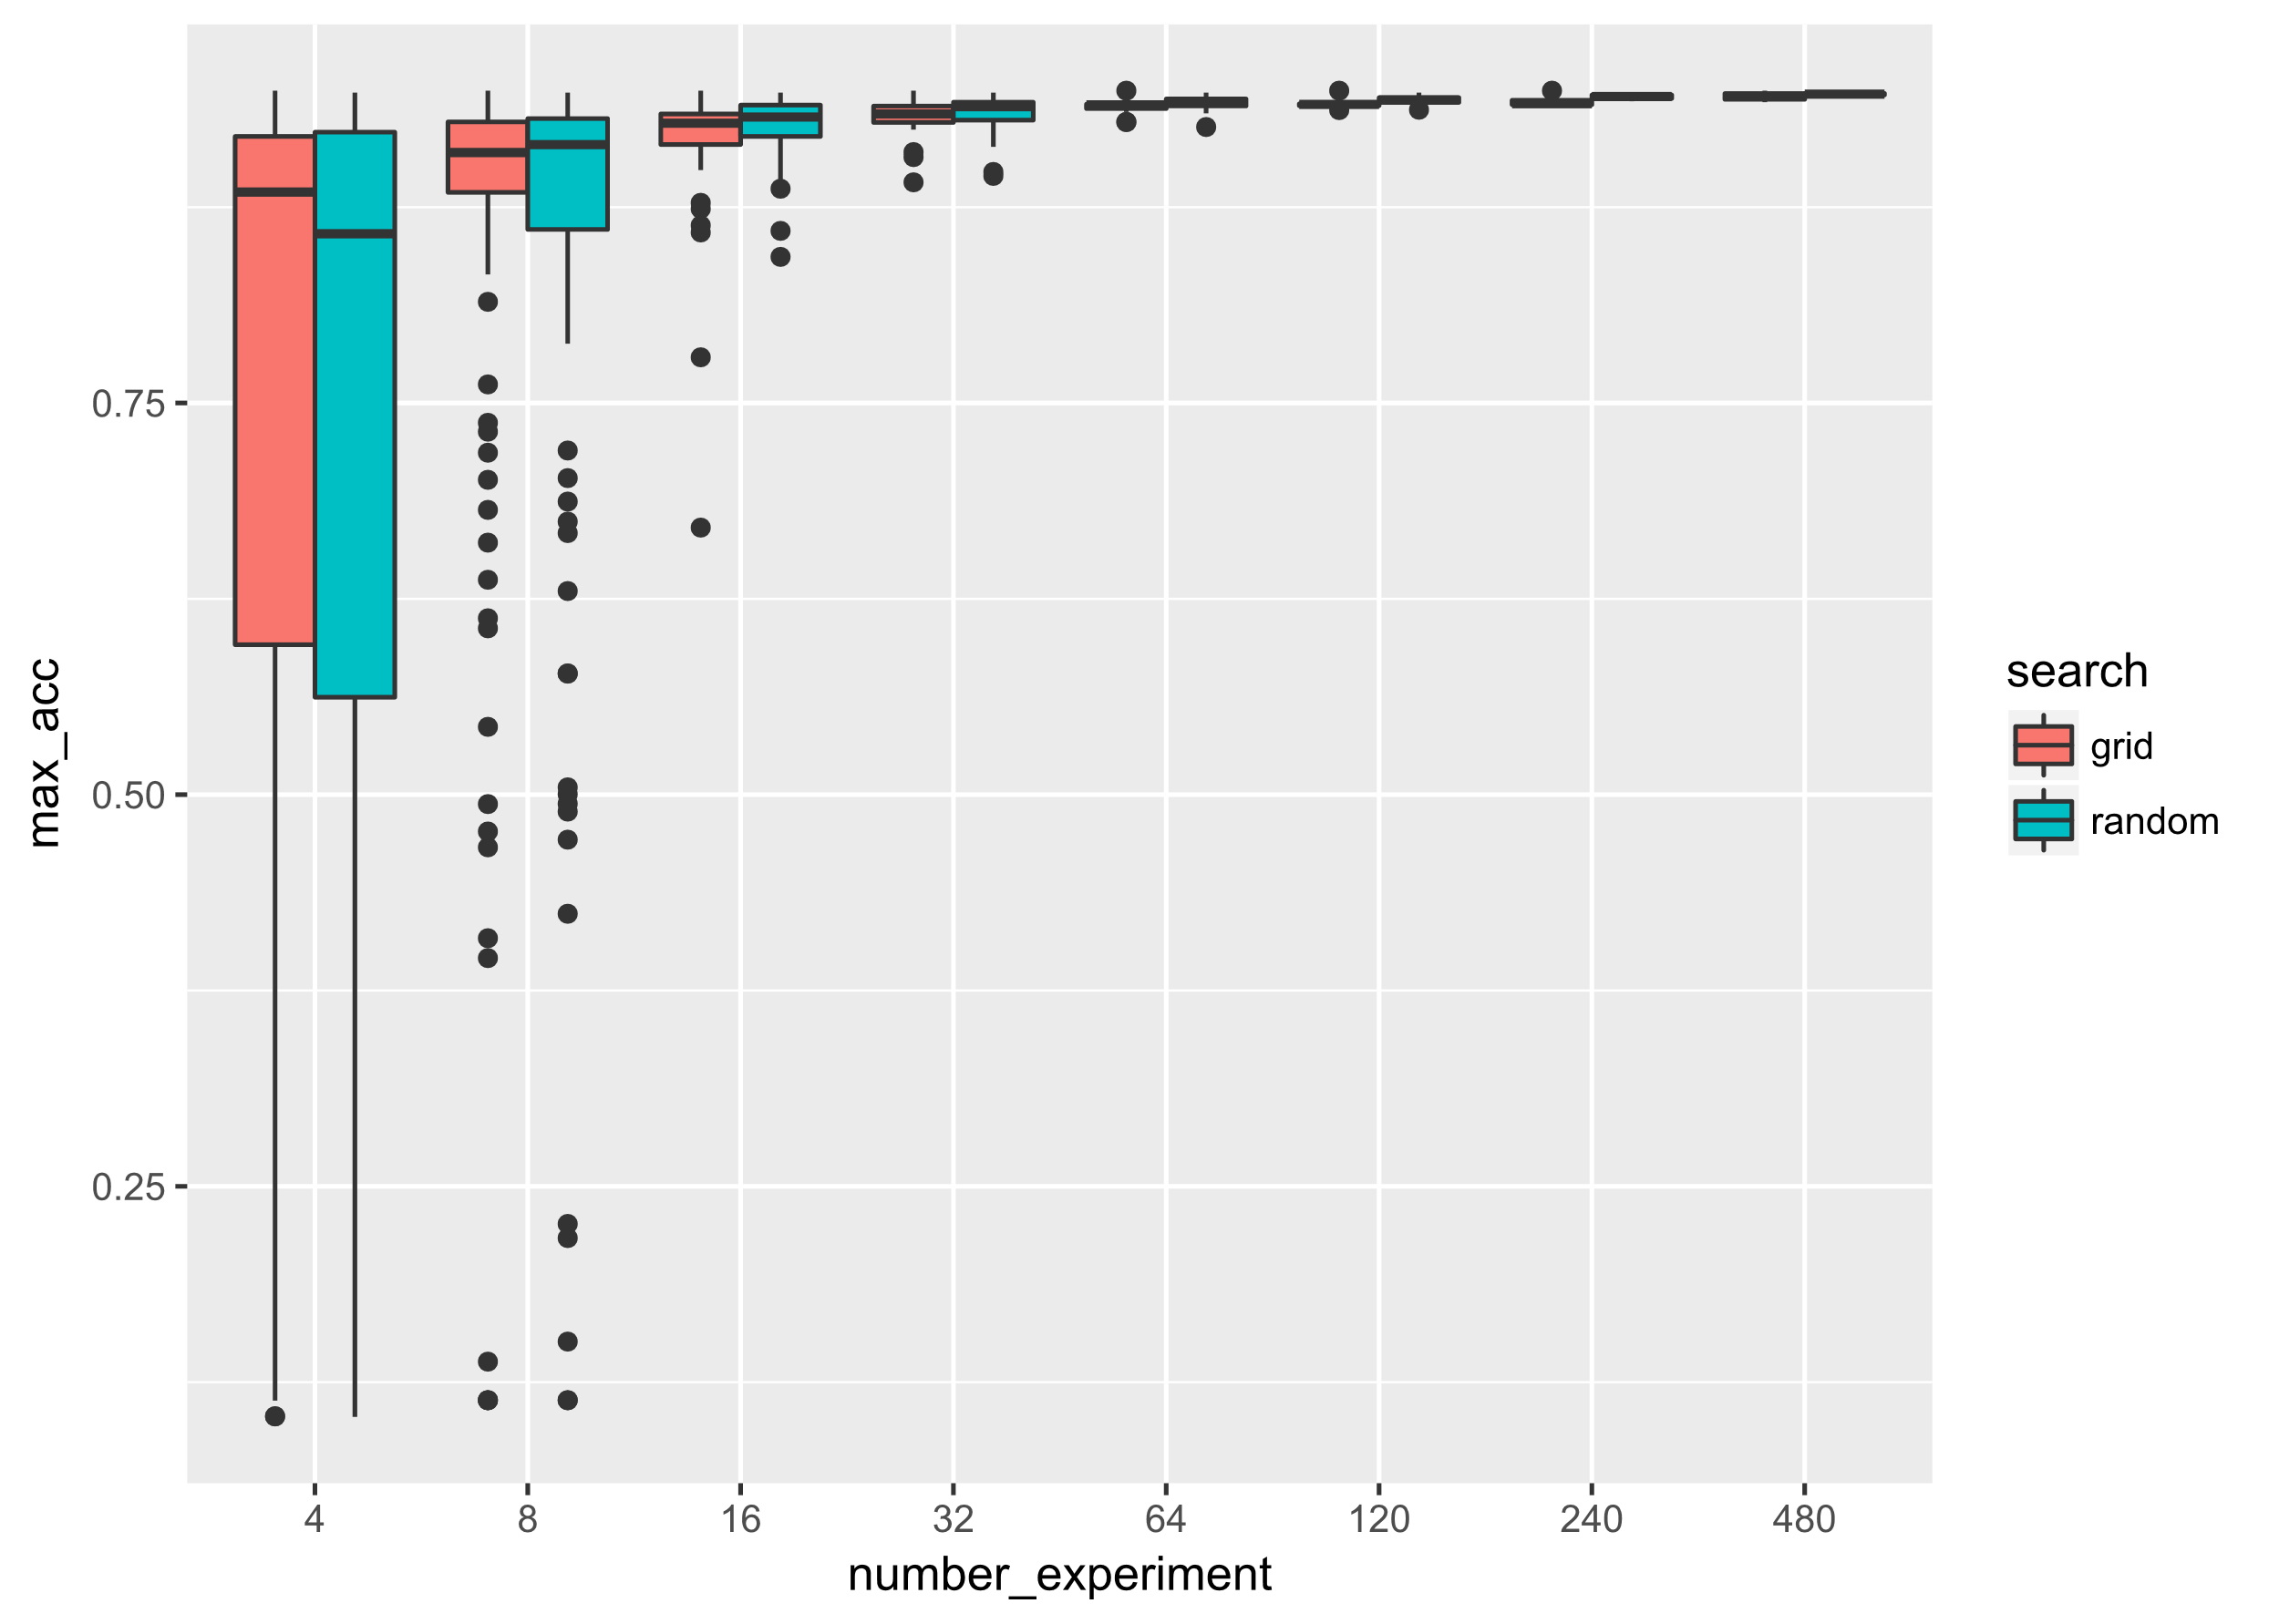
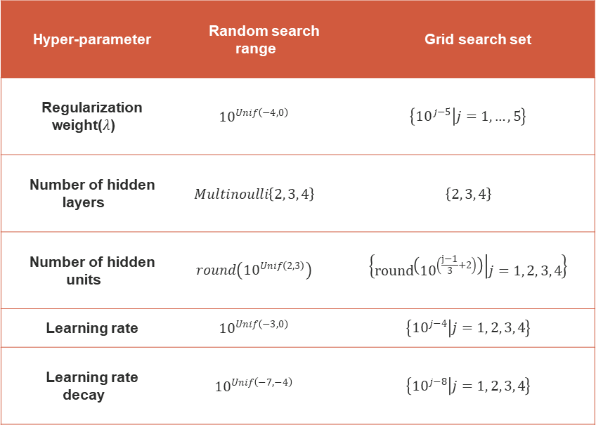
Artificial Neural Network
Hyper-parameter | Random search range | Grid search set
Regularization weight($λ$) | $${10}^{Unif\left(−4, 0\right)}$$ | $$\left\{{10}^{j−5} | j=1, …, 5\right\}$$
Number of hidden layers | $$Multinoulli\left\{2, 3, 4\right\}$$ | $$\left\{2, 3, 4\right\}$$
Number of hidden units | $$round\left({10}^{Unif\left(2, 3\right)}\right)$$ | $$\left\{round\left({10}^{\left(\frac{j−1}{3}+2\right)}\right) | j=1, 2, 3, 4\right\}$$
Learning rate | $${10}^{Unif\left(−3, 0\right)}$$ | $$\left\{{10}^{j−4} | j=1, 2, 3, 4\right\}$$
Learning rate decay | $${10}^{Unif\left(−7, −4\right)}$$ | $$\left\{{10}^{j−8} | j=1, 2, 3, 4\right\}$$
Figure 4 Neural network: number of experiments - from 4 to 480

Slide 15
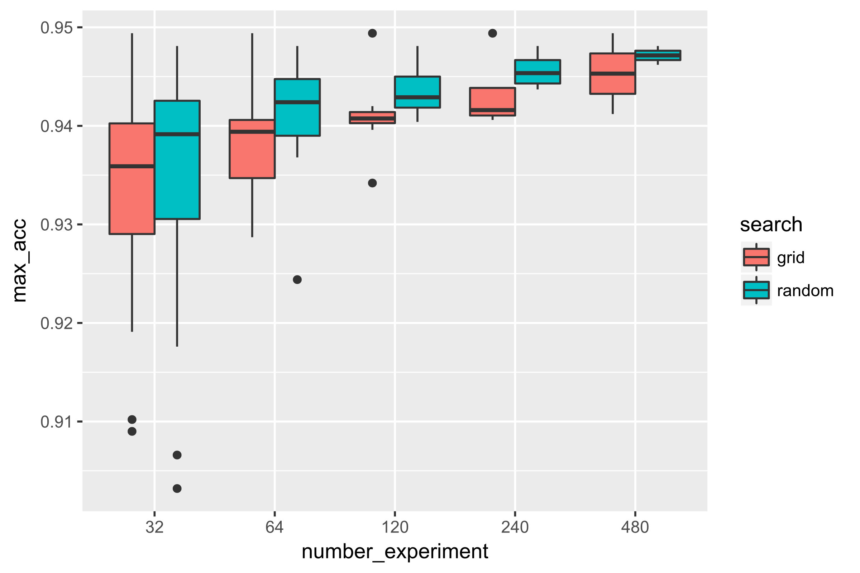
Artificial Neural Network
Results of experiment show that grid search method may be preferable when the number of experiments is small.
On the other hand, when the number of experiments is large, the random search method shows better results.
Figure 5 Neural network: number of experiments - from 32 to 480

Slide 16
Conclusions
The model with relatively few hyper-parameters such as logistic regression enabled the grid search method to work efficiently.
The model with many hyper-parameters such as the neural network shows that the random search method performs better than the grid search method as the number of attempts increases.
Using the random search method in modeling would be more efficient in terms of time, computation, and performance.

